Slide 1
Create your own one-page Roleplaying game
A DESIGN THINKING WORKSHOP
Aka.ms/ttrpgsatwork
Nina NAVAZIo
Thanks to:
Deepti Vaidyanathan
& William Assaf
AT HYPERSPEED
Notes:
Good morning everyone!
I want to start by saying that this presentation is normally an hour and a half long workshop, presented alongside my friends and coworkers Deepti Vaidyanathan and William Assaf, and this presentation wouldn’t be possible without them.
My name is Nina Navazio, and I’m a product designer and content designer 2 at Microsoft. I design experiences for Windows 11, ensuring that they are accessible, the writing is clear, and the whole flow is smooth. I’m also 3 quarters in to my Library and Information Science masters degree at the University of Washington, and I’m also a Dungeon Master, crafting games and sessions for my players consisting mainly of roleplay and puzzles. I’ve been playing since high school, and always enjoy showing players new and old how different roleplaying game systems can be just as amazing as the more popular ones.

Slide 2
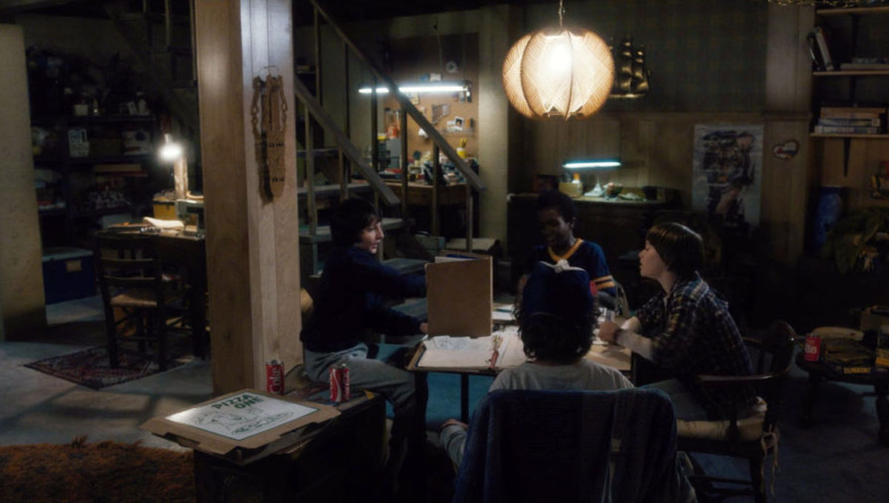
What is a tabletop role-playing game (TTRPG)?
CREATE YOUR OWN RPG
Stranger Things (season 1, episode 1)
Legal Stuff: This content and group is not affiliated with, endorsed, sponsored, or specifically approved by Wizards of the Coast LLC. Dungeons & Dragons® is a trademark[s] of Wizards of the Coast. For more information about Wizards of the Coast or any of Wizards' trademarks or other intellectual property, please visit their website at (www.wizards.com).
Notes:
Now, you may have heard of Dungeons and Dragons, and seen it on shows like Big Bang Theory or Community. Dungeons and Dragons is just one kind of TTRPG, just like Clue is one kind of board game.
Here, characters from Netflix's Stranger Things are playing Dungeons and Dragons. We can see the pretty common set of roles among them. There’s:
the Players,
<click>
and the Main Storyteller
<click>
(also known as the Game Master, Dungeon Master, or Keeper.)
Everyone here is playing the game, but the Main Storyteller knows more about the events that are going to unfold. They’ve prepared materials for the players to experience, and usually have a book or screen propped up in front of them for reference and to hide secrets from the players, like a dragon miniature or dice rolls.
Now, a game that you create could have a similar set up, with one person mainly telling the story and others acting as characters, but it could also be something entirely different, like a game with no main storyteller, or a single-player RPG.

Slide 3
WHY MAKE A One-PAGE TTRPG?
Core mechanic + core experience or theme or vibe.
Can share experiences, ideas, lessons, vibes
Playing them is more like improvisation
A design thinking exercise
Designing with empathy
Notes:
Let's zero in on our format of a *one-page* tabletop role-playing game. <click>
A *one-page* game focuses on a core mechanic, surrounded by a core experience.
We’re not creating thousands of pages of stories, reference tables, spell lists, and monsters, we’re just focusing on one core mechanic, and a short intro that can fit on one single sheet of paper. This restriction will hopefully be creatively freeing—or at least a springboard for a larger project.
<click>
A one-page game can focus on shared experiences and new ideas; used to teach or raise awareness of a specific topic; or explore a specific mood or vibe.
<click>
*Playing* a one-page game is closer to improvisation and open-ended creativity. Since it’s only one page, it’s just a loose framework for players to follow.
<click>
And creating a one-page RPG itself is an exercise in creativity, in ideation, and the empathetic people-focused process called design thinking, which I’ll talk about more later.

Slide 4
Empathize + Define: Game foundations
Topic: Brainstorm and select one topic to make into an RPG
Genres, media/movies/TV shows, personal experiences, random Wikipedia articles…
Inspirations: What are some media/games related to this topic? Is there anything they do that you could use in your game?
What tabletop games have you played and what were their rules?
Theme: How can you build "game feel" / vibes of the game?
If it's a scarier situation, what makes it scary? How do you raise the stakes?
If it's a silly game, how can players get silly?
What are some "actions" that people do related to that topic?
What do players do a lot? How does the world change the player?
Game mechanics/rules will determine the outcome of actions
Notes:
In order to make a one-page RPG, we start with empathizing and defining.
<click>
Begin by picking a topic. This can be as general as a genre or as specific as a TV show. I’ve created games based on Wikipedia articles, and favorite memories I have.
<click>
Next, outline more inspirations based on the topic you’ve picked.
What are some related games, shows, and movies that are related to your core topic?
<click>
Now that you’ve got a core topic and several related pieces of media, we’ll decide on a “theme”. What sorts of vibes does your game give? Should it be bright or dark? Cooperative or competitive? Here, we’re looking to get more explicit about how we want players to feel while playing the game. List four or five words like that for your theme, so any decisions you make for your game going forward, from typography to art to types of rules can be guided by the theme.
<click>
Finally, make a list of some “actions” that people take related to your topic. What kinds of things would the players be reasonably expected to do? For example, when I made a game about taking a road trip, I knew the biggest part of it would be how much you have to go pee. There’s also the fact that there isn’t a lot of space in the car, so you have to compromise comfort and keeping the peace. These sorts of things will inform the mechanics that will be in the center of gameplay.

Slide 5
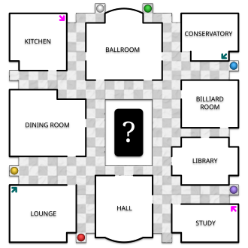
Ideate: TURN ACTIONS INTO GAMEPLAY
The core of an RPG, or any game, is its “mechanics”
According to Wikipedia: Rules and parts of a game “that govern and guide the player's actions, as well as the game's response to them.”
What makes players feel special?
Customization is key (within reason)
Focus on attributes players can pick that help build a backstory
Consider single or multi-player, with a Dungeon Master (DM) or DM-less
“The classic board layout” from Wikipedia: “Cluedo”
wikipedia.org/wiki/Cluedo
Notes:
To turn those actions into gameplay, we’ll first go over what a “mechanic” is.
<click>
As defined by Wikipedia, mechanics are the rules and parts of a game that “govern and guide the player’s actions, as well as the game’s response to them.” These are the “actions” you take in a game. For example, in the game Clue, players compete as investigators trying to solve a crime. Mechanics in that game include moving around the board, making accusations, reviewing evidence, and taking notes.
Similarly, RPGs have mechanics that relate to their themes. Like in Dungeons and Dragons, fighting enemies is a huge pillar of gameplay and so how protective your armor is, how strong you are, and what kinds of weapons you have are all tracked on your character sheet and used in combat mechanics.
<click>
When designing a mechanic, consider what makes a player feel special. These games are collaborative storytelling games, and everyone wants to feel like the main character of their own story. How does your mechanic allow for players to customize their characters, especially related to building a backstory? In Dungeons and Dragons, creating your character literally means assigning numbers to different attributes like strength or charisma. This determines your characteristics, like how acrobatic you are or how persuasive you are.
<click>
Finally, the decision of whether your game has a main storyteller or not, or maybe whether it’s even meant to be played in a group or on your own can be a mechanic. Consider the game “The Quiet Year,” where players gather to tell the story of a community building a colony together. Players determine what challenges they face, what projects they build, and what history they make together. There is no main storyteller—everyone in the game has equal footing in the story, just like the characters in it. They’re all experiencing this world for the first time, and are learning about it together. In this way, the choice of having no main storyteller adds to the game as a mechanic.
So, considering all this, take a look of the list of “actions” you made around your topic. Pick the top one or two, and consider how you could turn those into game mechanics. How could rolling dice, drawing from a deck of cards, or other creative activities simulate those actions? How can you keep it interesting, collaborative, and improvisational?

Slide 6
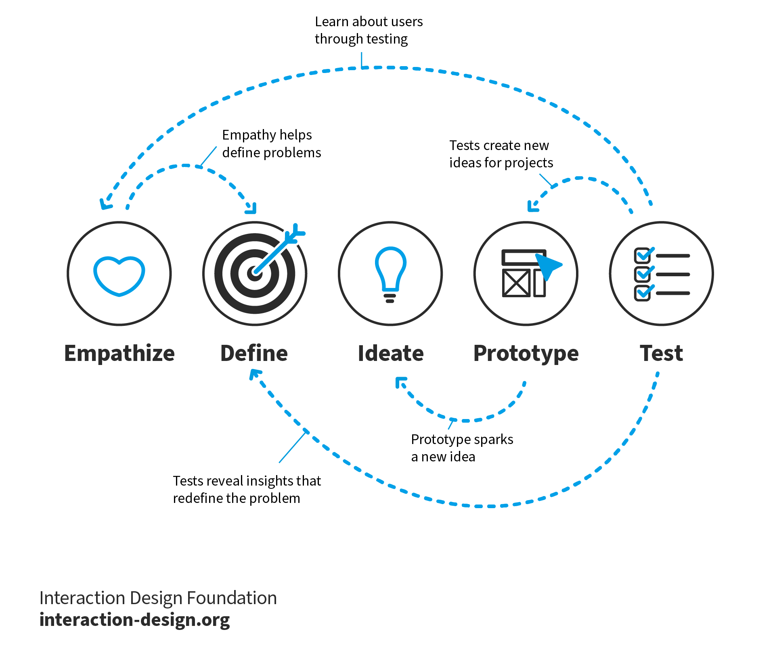
Design thinking
“Design Thinking is a discipline that used the designer’s sensibility and methods to match people’s needs to what is technologically possible and a viable business strategy to convert into customer value and market opportunity.” – Tim Brown
Design thinking is a way to create anything, work on any project, in a way that is human-centered at its core and favors progress over perfection
Notes:
Although it went by quick, we just followed the steps of design thinking.
<click>
Originally adapted for business purposes by the design consultancy IDEO and its founder Tim Brown,
<click> it’s a way to understand needs and challenges, and find solutions to problems in a way that’s human-centered at its core and favors progress over perfection. ​
The trick in design thinking is to get into the shoes of the people you’re designing for, to understand what they want and empathize with them in every step of the design process.
<click>
Doing that allows us to build robust solutions as we iterate through multiple stages of
<click>
empathizing with our audience,
<click>
defining our problem space
<click>
generating ideas for solutions,
<click>
prototyping the best ideas,
<click>
and testing these prototypes to gather feedback. Then integrate all that into our next iteration.
Frequently, development in one stage can lead to updates in any or all stages.
<click>
The design thinking framework encourages us to bounce between stages of design so we can maintain creative freedom while keeping our ideas organized.

Slide 7
Design thinking
What you did:
Empathize – you thought about a topic, and considered your game mechanics from the player’s POV
Define and Ideate – you thought about the fun in the game and defined the rules.
What's next:
Prototype – you can write a playable draft of your game's rules
Test – you can test your prototype by having someone else play your game and give feedback on what worked and what didn't
Iterate – you can repeat this process to integrate feedback into new drafts of your game
The 5 Stages in the Design Thinking Process | IxDF (interaction-design.org)
Notes:
When we were working on our RPGs,
<click>
we started out by picking a topic and empathizing with our “audience”, or players of our game, so that we could describe what they should be able to do and/or experience while playing the game.
<click>
When we had a sense of what we wanted our game to look like, we defined game mechanics that would help our players experience the events that occur in our game and how we could build the “fun” in the game.
<click>
And next, you’d write a playable draft of your games rules on one page of paper, to truly make it a onepage RPG.
<click>
Then you can call up some friends and set up a game night to actually playtest your game.
<click>
And finally, don’t forget to iterate! Repeat the process to continue to integrate feedback into new drafts of your game until your comfortable sharing the first version of it. Keep in mind that iteration doesn’t always mean adding more rules to your game, especially when designing a one page RPG. Every iteration should bring you back to the ultimate goal of your game: whether that’s to share an experience, raise awareness for something, or tell a certain kind of story. But always remember that iterating sometimes leads to broadening your rules or removing some all together–whatever makes sense to get your ideas across.

Slide 8

Thanks!
RPGs | Notes
Dungeons and Dragons | Common table-top roleplaying game, seen in Stranger Things, Big Bang Theory, etc
Lasers & Feelings | Well designed one-page RPG
Cats in the City | By Deepti, using this workshop’s format; “chaos” mechanic
Ten Candles | “Candle” mechanic where real, lit candles impact gameplay
The Quiet Year | No “Mian storyteller”, players can hold “grudges”
Everybody’s John | Bidding mechanic to “gain control” of the story
Road Trippin’ | By nina, “Pee meter” that impacts game play
Astronomers | By nina, drawing cards simulates discovering planets
Alice is Missing | Completely silent; No game master; players must text each other
Dread | Horror style game where a game of Jenga is used for tension
Caravan | In Fallout: New Vegas, can only use cards you find in game
Gwent | In Witcher games, you can only get cards from boss fights
Or download slides here:
https://aka.ms/ttrpgsatwork
TO DO…
Fill out the worksheets
Write the rules on ONE PAGE
Test the game with friends
Iterate on the game
Publish! Consider: DMs Guild, DrivethruRPG, Roll20, Itch.io, GitHub
Notes:
And that’s it! Here are a bunch of resources on the page, including a to-do list if you’re interested in following through with your ideas from today, as well as a QR code to this and all our other presentations. There’s also a list of roleplaying and video games that have interesting mechanics. Please feel free to use the workshop and its accompanying worksheets with your friends, family, and communities however you see fit.
And please come chat with me after these talks or any time today at the conference. I’m more than happy to connect with you about roleplaying games, and how they empower people design experiences and express themselves. We’ve all got unique stories to tell, so why not play them? Thank you for your time!

